Slide 1
Asp.net and c#
Lecture
Topic:
Control statement

Slide 2
C# if-else
In C# programming, the if statement is used to test the condition. There are various types of if statements in C#.
if statement
if-else statement
nested if statement
if-else-if ladder
C# IF Statement
C# If Example
using System;
public class IfExample
{
public static void Main(string[] args)
{
int num = 10;
if (num % 2 == 0)
{
Console.WriteLine("It is even number");
}
} } output:It is even number
C# IF Statement
The C# if statement tests the condition. It is executed if condition is true.
Syntax
if(condition){
//code to be executed
}
if(condition){
//code to be executed
}

Slide 3
C# IF-else Statement
Syntax:
if(condition){
//code if condition is true
}else{
//code if condition is false
}
The C# if-else statement also tests the condition. It executes the if block if condition is true otherwise else block is executed.
C# If-else Example
using System;
public class IfExample
{
public static void Main(string[] args)
{
int num = 11;
if (num % 2 == 0)
{ Console.WriteLine("It is even number"); }
else
{ Console.WriteLine("It is odd number"); } } }
Output:
It is odd number

Slide 4
C# If-else Example: with input from user
In this example, we are getting input from the user using Console.ReadLine() method. It returns string. For numeric value, you need to convert it into int using Convert.ToInt32() method.
using System;
public class IfExample
{
public static void Main(string[] args)
{
Console.WriteLine("Enter a number:");
int num = Convert.ToInt32(Console.ReadLine());
if (num % 2 == 0)
{ Console.WriteLine("It is even number"); }
else
{ Console.WriteLine("It is odd number"); } } }
Output:
Enter a number:11It is odd number Output:
Enter a number:12It is even number

Slide 5
C# IF-else-if ladder Statement
The C# if-else-if ladder statement executes one condition from multiple statements.
Syntax:
if(condition1){
//code to be executed if condition1 is true
}else if(condition2){
//code to be executed if condition2 is true
}
else if(condition3){
//code to be executed if condition3 is true
}
...
else{
//code to be executed if all the conditions are false
}

Slide 6
C# If else-if Example
using System;
public class IfExample
{ public static void Main(string[] args)
{ Console.WriteLine("Enter a number to check grade:");
int num = Convert.ToInt32(Console.ReadLine());
if (num <0 || num >100)
{ Console.WriteLine("wrong number");
}
else if(num >= 0 && num < 50){
Console.WriteLine("Fail");
}
else if (num >= 50 && num < 60)
{
Console.WriteLine("D Grade");
}
else if (num >= 60 && num < 70)
{
Console.WriteLine("C Grade");
}
else if (num >= 70 && num < 80)
{
Console.WriteLine("B Grade");
}
else if (num >= 80 && num < 90)
{
Console.WriteLine("A Grade");
}
else if (num >= 90 && num <= 100)
{
Console.WriteLine("A+ Grade");
}
}
}
Output:
Enter a number to check grade:66C Grade Output:
Enter a number to check grade:-2wrong number

Slide 7
C# switch
The C# switch statement executes one statement from multiple conditions. It is like if-else-if ladder statement in C#.
Syntax:
switch(expression){
case value1:
//code to be executed;
break;
case value2:
//code to be executed;
break;
......
default:
//code to be executed if all cases are not matched;
break;
}

Slide 8
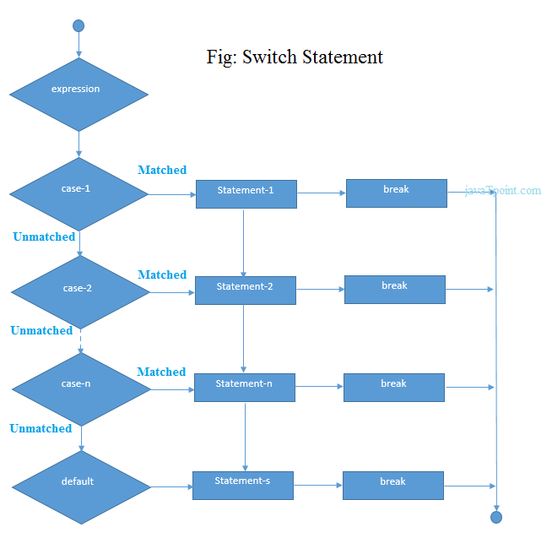

Slide 9
C# Switch Example
using System;
public class SwitchExample
{
public static void Main(string[] args)
{
Console.WriteLine("Enter a number:");
int num = Convert.ToInt32(Console.ReadLine());
switch (num)
{
case 10: Console.WriteLine("It is 10"); break;
case 20: Console.WriteLine("It is 20"); break;
case 30: Console.WriteLine("It is 30"); break;
default: Console.WriteLine("Not 10, 20 or 30"); break;
}
}
}
Output:
2.3M
250
History of Java
Enter a number:10It is 10 Output:
Enter a number:55Not 10, 20 or 30 Note: In C#, break statement is must in switch cases.

Slide 10
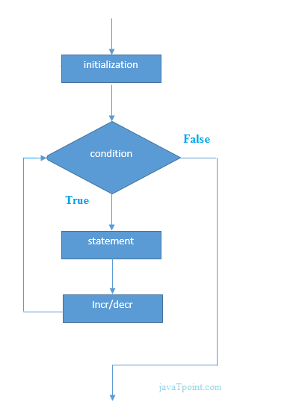
C# For Loop
The C# for loop is used to iterate a part of the program several times. If the number of iteration is fixed, it is recommended to use for loop than while or do-while loops.
The C# for loop is same as C/C++. We can initialize variable, check condition and increment/decrement value.
Syntax:
for(initialization; condition; incr/decr){
//code to be executed
}

Slide 11
C# For Loop Example
using System;
public class ForExample
{
public static void Main(string[] args)
{
for(int i=1;i<=10;i++){
Console.WriteLine(i);
}
}
}
Output:
1
2
3
4
5
6
7
8
9
10

Slide 12
C# Nested For Loop
In C#, we can use for loop inside another for loop, it is known as nested for loop. The inner loop is executed fully when outer loop is executed one time. So if outer loop and inner loop are executed 3 times, inner loop will be executed 3 times for each outer loop i.e. total 9 times.
Let's see a simple example of nested for loop in C#.
using System;
public class ForExample
{
public static void Main(string[] args)
{
for(int i=1;i<=3;i++){
for(int j=1;j<=3;j++){
Console.WriteLine(i+" "+j);
}
}
}
}
Output:
1 1
1 2
1 3
2 1
2 2
2 3
3 1
3 2
3 3

Slide 13
C# Infinite For Loop
If we use double semicolon in for loop, it will be executed infinite times. Let's see a simple example of infinite for loop in C#.
using System;
public class ForExample
{
public static void Main(string[] args)
{
for (; ;)
{
Console.WriteLine("Infinitive For Loop");
}
}
}
Output:
Infinitive For LoopI
nfinitive For Loop
Infinitive For Loop
Infinitive For LoopI
nfinitive For Loop
ctrl+c

Slide 14
C# While Loop

